Slide 1
Spring 2017 Department Representative Meeting
April 26, 2017

Slide 2
Welcome!
Sarah Mirkin
HR Communications Manager

Slide 3
Thank You to Our Partners
College of Medicine
Office of Business Services

Slide 4
Finance & Administration Update
Kyle Clark
Vice President for Finance & Administration

Slide 5
Human Resources in 2017
Renisha Gibbs
Assistant Vice President for Human Resources
Finance & Administration Chief of Staff

Slide 6
Focus for the Year
Process Improvement
Simpler
Eliminate unnecessary procedures
Paperless
Training
Updating and expanding training resources
Strategic Plan Implementation
Workgroups

Slide 7
2017 Projects
Process Improvement Smart Onboarding Recruiting Enhancements TimeclockPlus Fingerprinting Office | Training Sexual Misconduct Faculty Search Committee Staff Search Committee NCBI (Diversity & Inclusion) Appointment Tutorial

Slide 8
Administration Change
Potential HR Impacts
Affordable Care Act (ACA)
Fair Labor Standards Act (FLSA) Overtime Regulations
HR will monitor, assess, and communicate any changes that will impact campus.

Slide 9
Faculty Search Committee Training & National Coalition Building Institute Training
Michelle Douglas
Director, Organizational Development and
Equal Opportunity & Compliance

Slide 10
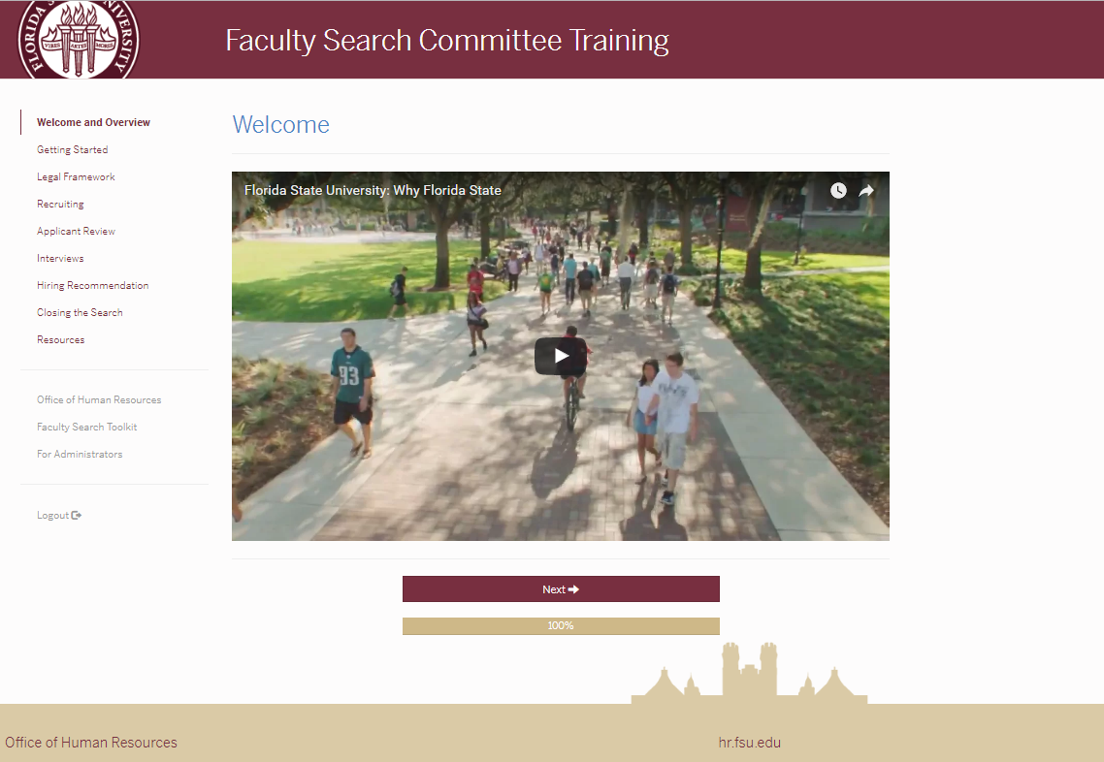
Faculty Search Committee Training
Practical and convenient online training that takes you through all phases of the recruiting process, including:
Creating a search committee and defining roles.
Building the best applicant pool through active recruiting.
Interviewing do’s and don’ts.
Legal, recordkeeping, and university requirements.
Welcoming a new colleague into your department.

Slide 11
Faculty Search Committee Training
Special Features
Diversity Resources
Implicit Bias Assessment-IAD
Toolkit
Go Live — Fall 2017

Slide 12
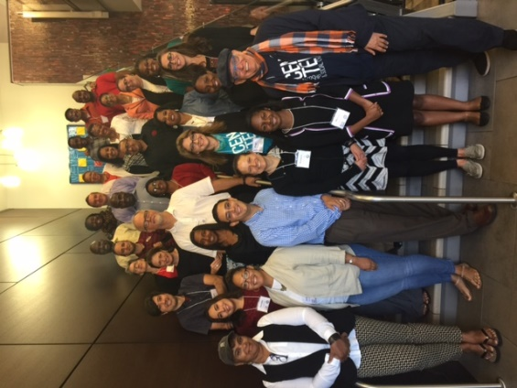
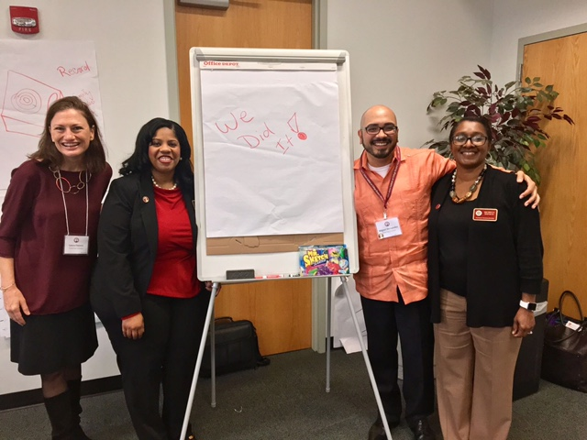
National Coalition Building Institute(NCBI) FSU Team

Slide 13
NCBI Training Opportunities
Pilot workshops in progress
Fall 2017
One-day workshops
August: schedule announced
http://hr.fsu.edu/?page=training/training_home

Slide 14
Background Check Updates
Andrew Kapec
Background Check Manager,
Employment & Recruitment Services

Slide 15
New HR Fingerprinting Office
Hours
Monday-Friday: 8 am-4:45 pm
Location
Main HR, University Center Suite A6200
Fingerprinting for regular Level 2, Summer Camp, & Child Care
Work with HR to prepare for large groups
FSUPD still available for fingerprinting
Tuesday-Friday: 1-3 pm

Slide 16
2017 Summer Camps
Requirements
All new and rehired camp personnel require background checks through DCF
Includes: owners, operators, employees, & volunteers
Checks can only be initiated within 60 days of camp start date
Can submit complete roster earlier to begin research process
Request forms not required for each employee

Slide 17
2017 Summer Camps
Current Florida K-12 Public School Teachers may be exempt if:
No 90 day break in service from teaching job and
Employer submits memo verifying completion of background check
Template memo on Background Check Website

Slide 18
2017 Summer Camps
Forms
From Departments:
Summer Camp Roster (new)
Replaces Request Form for Summer Camp checks
Include all personnel regardless of employment status/history
One Blanket Questionnaire for each camp
From Candidates:
Clearinghouse Demographic Sheet
Clearinghouse Privacy Policy
Affidavit of Good Moral Character
Do not send to HR, unless a disqualifying offense is disclosed

Slide 19
myFSU Mobile App
Rebekah Dorn, Ph.D.
Assistant Director, ITS User Experience

Slide 20
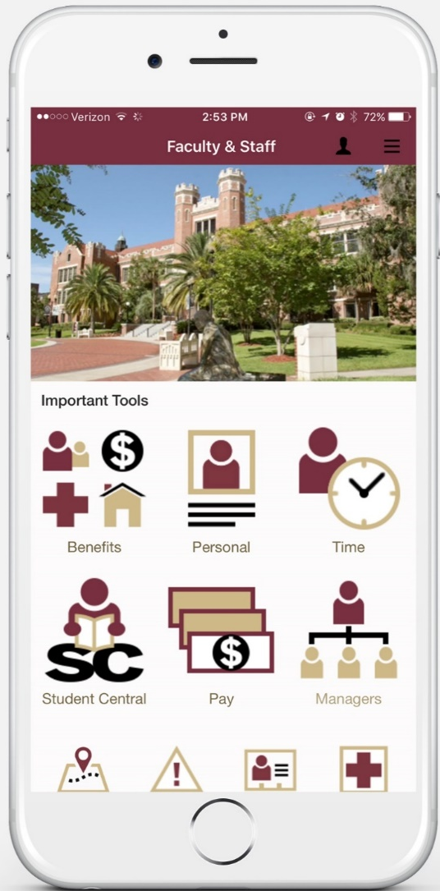
What can I do on the myFSU Mobile App?

Slide 21
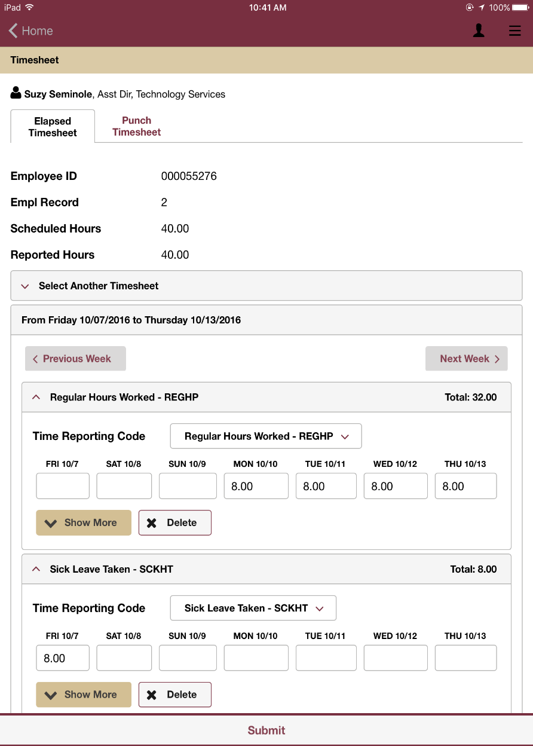
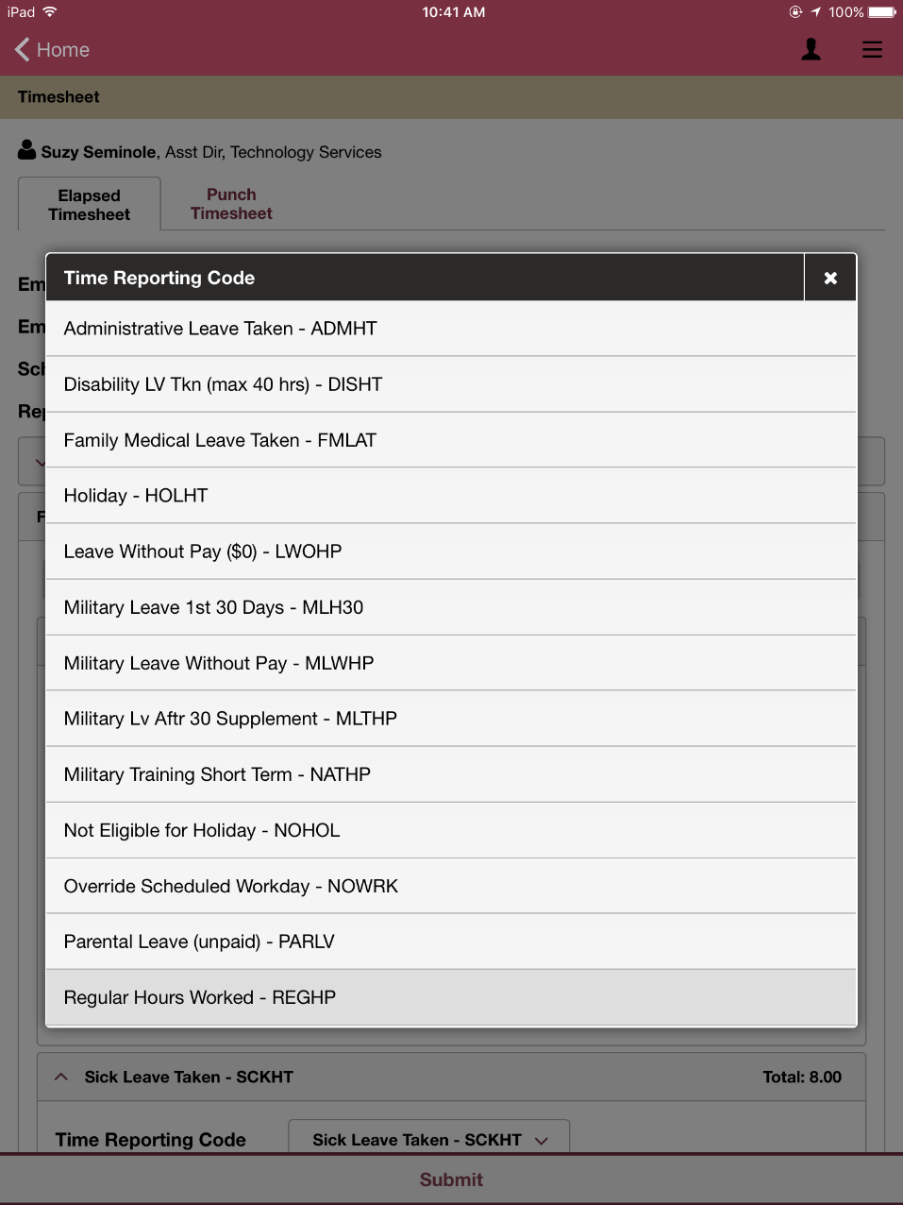
Enter Time
Enter time by work week or pay period.
The same Time Reporting Codes available as you see now.

Slide 22
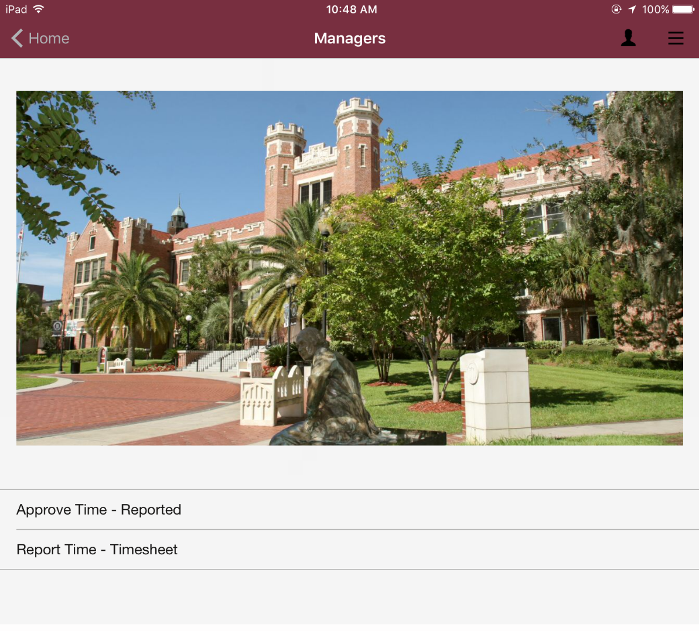
Manager- Approve time/Report time

Slide 23
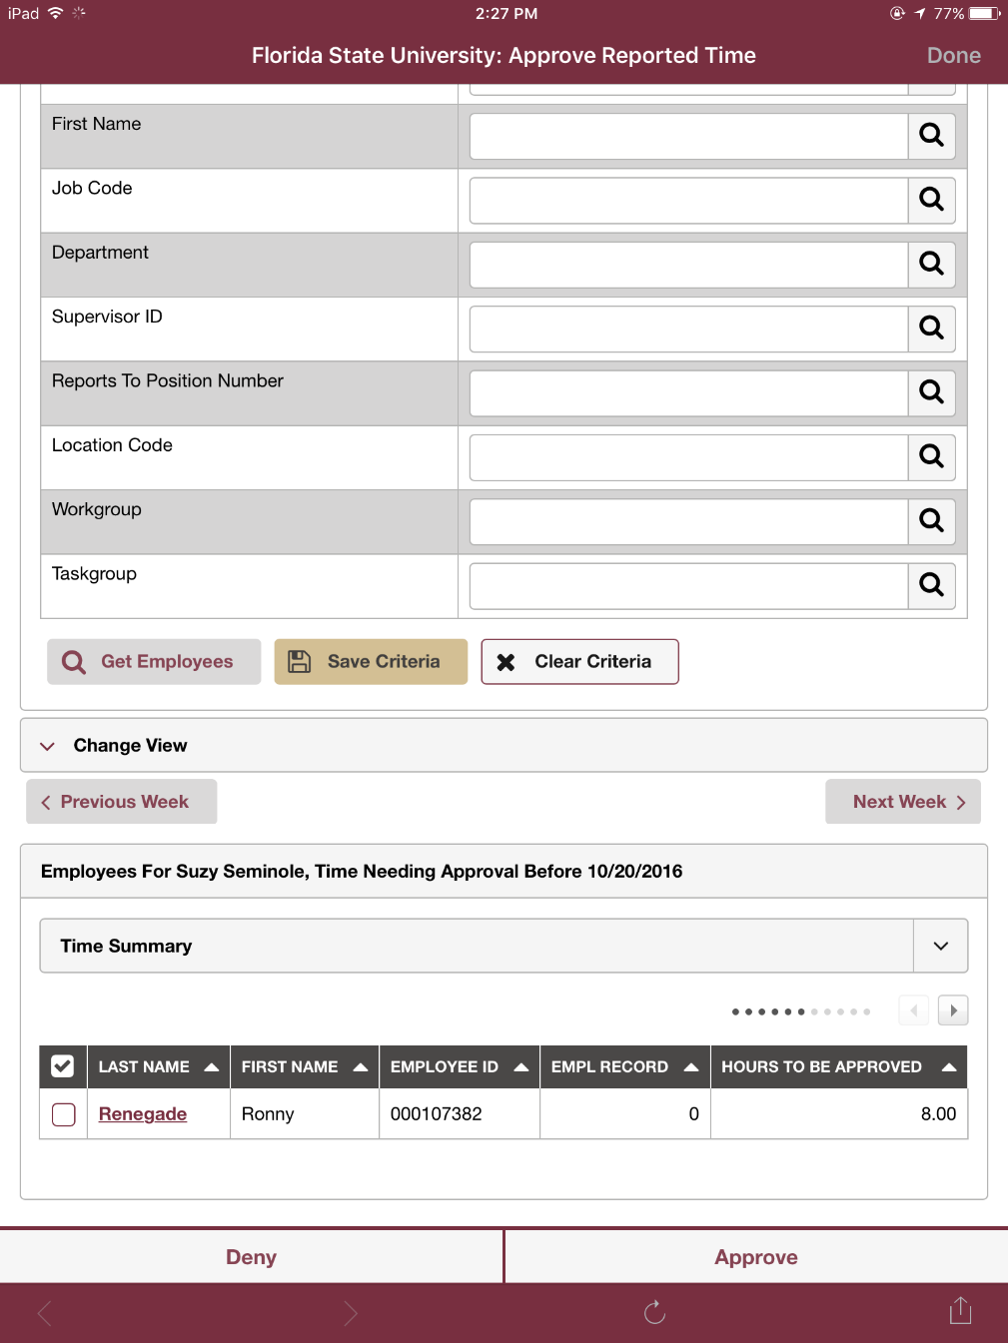
Approve time by Group ID or by individual employee timesheet

Slide 24
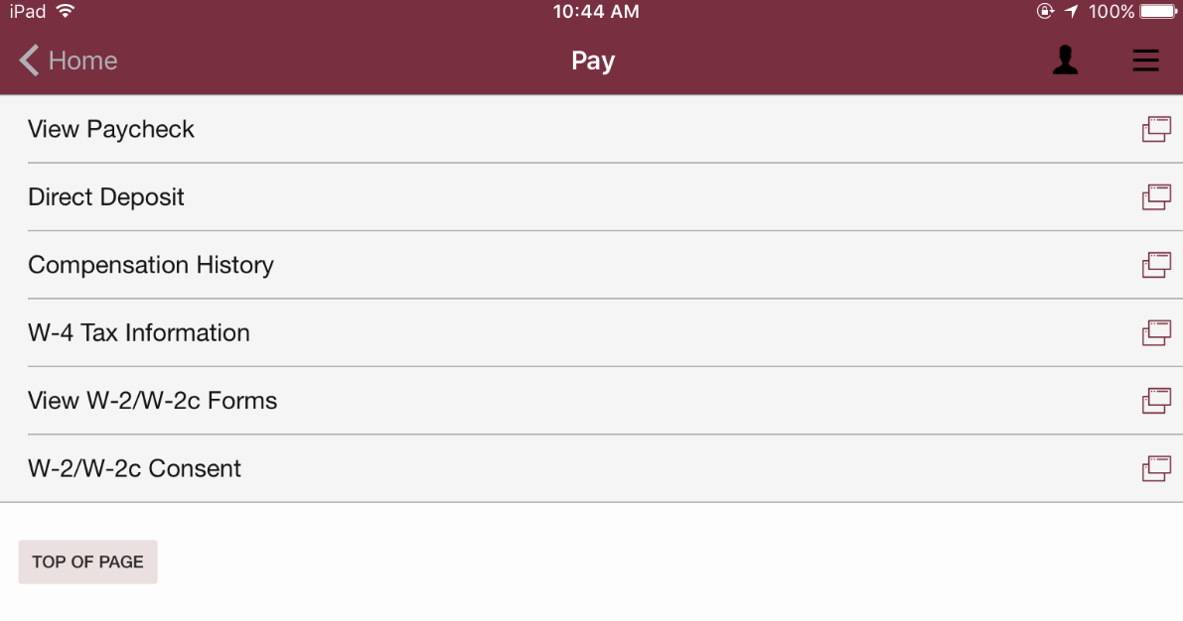
Employees can view their paycheck, update direct deposit, view W-2 Forms, review benefits & so much more!

Slide 26
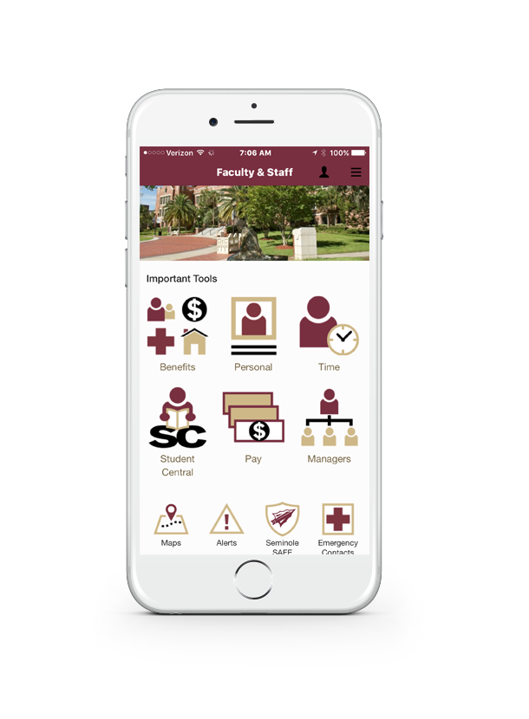
Download the myFSU Mobile App
Complete the Follow-Up Survey
Promote the myFSU Mobile App

Slide 27
Information Technology Services Update
Maria Whitaker
Associate Director, Identity and Access Management

Slide 28
System Updates and Business Process Changes
Retiring FSUSN
3/30/2017
Oracle Identity Manager Project
Password Resets
Password Expiration
Self-Service Challenge Questions
FSUID Change Process

Slide 29
Federal Work Study
Miranda McMillan – Assistant Director, Work Study
Sherron Sloan – Associate Director, OFA
Somnath Chatterjee – Sr. Associate Director, OFA
Office of Financial Aid

Slide 30
Work Study Program - Overview
Federal need based program(s)
Federal Work Study Program
Federal Community Service Program
Florida Work Experience Program

Slide 31
Student Engagement
FSU Strategic Goal V
Preparing our Graduates for 21st Century Careers
Streamline Application Process & enhance offering through collaboration
Office Of Financial Aid (OFA)
FSU Human Resources – Online job application process
FSU Career Center – Experiential Learning opportunities

Slide 32
Current Process Overview

Slide 33
FA Timeline
Students Awarded: April
Students Accept Award: May – Aug
Online FSU HR Job Posting – July
Students Search and Apply/Interview/Hire:
May – Aug
Payroll Ready
New hire paperwork complete: Aug 7, 2017
5 to 7 days for student to be payroll ready
Department reps to run report to determine who is ready

Slide 34
Common Issues
Variety of submission points for new hire paperwork – Solution: FSU Dropbox
Incomplete paperwork
I-9’s especially
Monitoring time sheets
Revision in pay rates after initial hire paperwork

Slide 35
New Work Study Job Portal – Coming Soon

Slide 36
New Work Study Job Portal – Coming Soon

Slide 37
Experiential Certificate Option
Offers the student and supervisor a structured process to define goals and provide feedback
Students sign up through SeminoleLink at start of term, after they are hired by department
Student receives a Certificate upon successful completion of program

Slide 38
Federal Work Study Training Dates
Who should attend?
Departmental Reps and Supervisors
What will we cover
Rollout of FSU Work Study online job posting site
HR/Payroll process
Background checks
Supervisor requirements
Student requirements

Slide 39
Work Study Training Dates
FSU Training Center
Sign up through Training Center link
May 17 1:30-3:00
May 22 9:30-11:00; 1:30 -3:00
May 23 1:30-3:00
Refreshments and door prizes !!!

Slide 40
Contacts
OFA work study address
Mrs. Miranda McMillan: mmcmillan@fsu.edu
Mrs. Sherron Sloan: ssloan@admin.fsu.edu
OFA Work Study website:
http://financialaid.fsu.edu/types-aid/federal-work-study

Slide 41
Door Prize

Slide 42
Smart Onboarding Update
Phaedra Harris
Director, HR Operations

Slide 43
HR initiative with ERP partnership to improve the onboarding process
Will create an electronic onboarding portal to streamline completion of new hire paperwork, background checks, & other pre-employment requirements.
Will feed directly to OMNI.

Slide 44
Project Status
Portal Design
Pilot Group
Campus Rollout
Inception & Vendor Selection

Slide 46
What Do Departments Need to Do?
Nothing yet
As the project develops and campus rollout approaches, expect to hear much more.
HR will provide training, job aids, and online resources.

Slide 47
Veterans Initiative
April Smatt
Sr. HR Specialist, Employment & Recruitment Services

Slide 48
Veterans Initiative
The Veterans Alliance arrowhead is the proud symbol of Florida State University’s campus-wide commitment to become a national beacon of veteran support and success.

Slide 49
How Can You Help?
Ensure your department is familiar with updated Veterans’ Preference laws.
Get involved—become a Veteran Liaison!
Refer veterans in need of employment assistance to Human Resources.
Refer students and employees with veteran benefits questions to the Student Veterans Center.

Slide 50
Veterans’ Preference Laws
Applies to USPS positions only
All USPS ads must include Veterans’ Preference statement
Applicants to be routed & vetted by HR Recruiter
Preference for consideration at every stage, starting with interview
Partner with your HR Recruiter if you’re having trouble reaching a Veterans’ Preference applicant

Slide 51
Veterans’ Preference Laws (Continued)
If veteran is equally ranked with other top candidate—choose the Veteran
Final decision to hire non-veteran is subject to HR review
If non-veteran hired, inform applicants within 14 days of candidate accepting offer that the job has been filled
Document recruitment process and basis for hiring
Keep on file for minimum of 4 years
HR website updated

Slide 52
Get Involved—Become A Veteran Liaison!
The Veteran Liaisons program provides support to student veterans by:
Helping ease the military-to-college transition, enriching the academic experience, improving the ability to graduate, and providing resources to help meet career or graduate school goals.
Networking opportunities
If your department does not have a liaison, contact Becky Culp at the Student Veterans Center (bculp@fsu.edu).

Slide 53
Review of Resources
FSU Jobs website
New forms, documentation matrix, and resources
Melissa Olson—HR Veteran Liaison (job search assistance, resources): jobs@fsu.edu.
Megan Hollis—Career Center Veteran Liaison (assistance with resume writing, mock interviews, resources): megan.hollis@fsu.edu.
Student Veterans Center
Cheryl Goodson—Assistant Director for Education Benefits: cgoodson@fsu.edu.

Slide 54
Break

Slide 55
Essential Piece Award
Renisha Gibbs
Assistant Vice President for Human Resources
Finance & Administration Chief of Staff

Slide 56
Essential Piece Award
Goes above and beyond in her duties as an HR representative each time I interact with her!
Shows great compassion, responsiveness, care, and responsibility to new hires and current employees, helping them navigate multi-faceted benefit inquiries and enrollments.
Always has a very professional, caring, courteous, and pleasant attitude.
Treats everyone and every matter with respect, professionalism, and makes sure that issues are resolved in a timely manner.
Able to plan, coordinate, and oversee successful events, taking care of the smallest details to make sure everything runs smoothly. She is a joy and pleasure to work with, which makes all of our jobs much easier!

Slide 57
Wanda Brooks Administrative Specialist, Panama City
Spring 2017 Outstanding Department Representative and Essential Piece Award Winner

Slide 58
Attendance & Leave Updates
Jonathan Banks
HR Specialist, Attendance and Leave

Slide 59
TimeClock Plus (TC+)
What?
Time and Attendance solution for capturing punch time.
FSUCard Swipe Device
Who?
Based in San Angelo, Texas
Established in 1988
Currently serving 70,000 clients

Slide 60
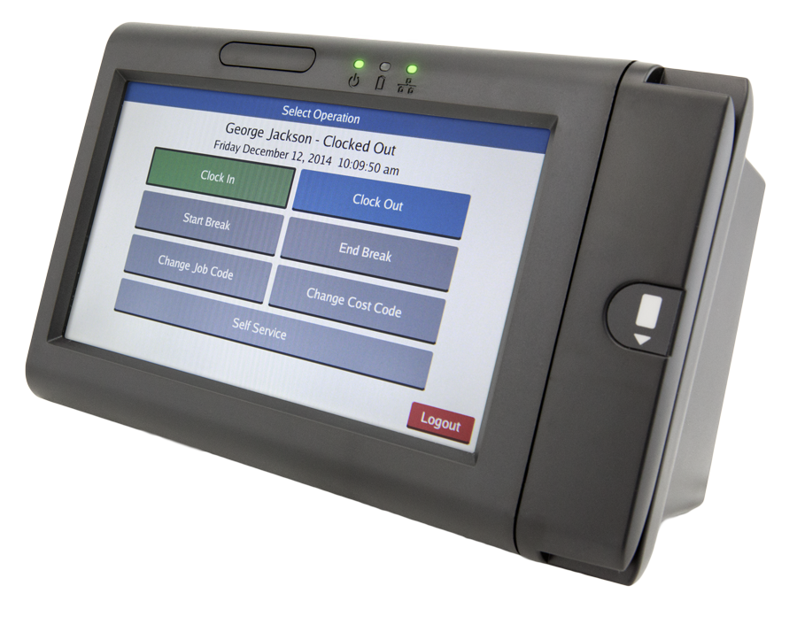
TimeClock Plus & FSU
Small campus population will transition from Kronos Clocks to TimeClock Plus.
Approximately 350 users in Public Safety, Parking & Transportation, Postal Services, and Ringling.
Phase 2: Building Services and Grounds
Is your department interested?

Slide 61
TimeClock Plus Timeline

Slide 62
Timesheet Reminders
Employee is on an elapsed timesheet and normally scheduled to work Monday through Friday for 8 hours each day.
However, the following week the employee was approved to flex their schedule—taking OFF on Friday and working 10 hours each day on Monday through Thursday

Slide 63
Override Work Schedule

Slide 64
Should I Enter my Holiday?
Elapsed Timesheet Reporters
A&P, USPS Exempt, Departments on Paper Timesheets
NO

Slide 65
Should I Enter my Holiday?
Punch Timesheet Reporters
USPS Nonexempt
YES

Slide 66
Meal Periods vs. Breaks
What is a Meal Period?
According to the Fair Labor Standards Act (FLSA), a bona-fide unpaid meal period should typically be at least 30 minutes; the employee must be completely relieved of work and is required to punch OUT on the timesheet.
What is a Rest Period (Break)?
According to FSU policy, upon supervisor approval, employees may be allowed two 15-minutes breaks, during the first and second half of their work day. Breaks of 15 minutes or less are paid and the employee is not required to punch OUT on the timesheet.

Slide 67
Meal Periods vs. Breaks

Slide 68
Appointment Tutorial Resources & Upcoming Recruiting Enhancements
Abigail Lejeune
Assistant Director, Employee Data Management

Slide 69
New Appointment Tutorial Website Coming Soon!
When?
Summer 2017
What is it?
Reference guide for HR Department Representatives on:
appointment processes,
paperwork requirements, and
timelines for payroll processing.

Slide 70
New Appointment Tutorial Website - Topics
Planning and Preparation for New Hires and Rehires
pPAF Procedures
Job Offers
New Employee Forms
Non-US Citizen work authorization documents
Tips for Reviewing Active Employees and Cost Center Reports
Payroll deadlines

Slide 71
New Appointment Tutorial Website – Topics
Modifying Active Appointments
ePAF Reappointments
Termination actions
Procedures for Additional Jobs
Dual Compensation forms
FSU Service Center Cases
How to enter a case?
When is a case needed?
What to include in a case?

Slide 72
I-9 Instructional Resource
Don’t forget about our I-9 Instructional Website.
Topics include:
Sections on the I-9 form
Acceptable documents
Remote hire process
Guardian dashboards and tutorials
Non-US citizen I-9 forms

Slide 73
Upcoming Recruiting Enhancements OPS Faculty Express
Modeled after the GA Express process
Create applicant record, link, and create job offer
Offers will automatically route through electronic approval chain before coming to HR for processing

Slide 74
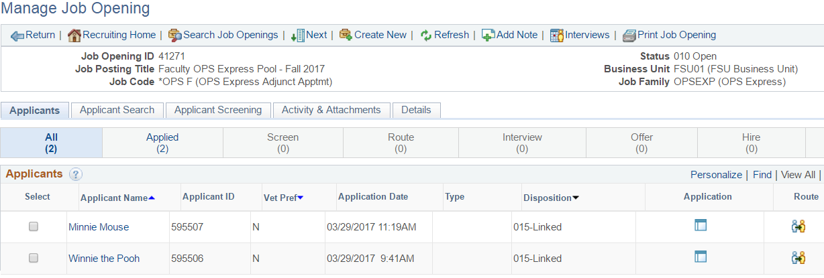
Upcoming Recruiting Enhancements OPS Faculty Express
Creates a paperless process for OPS Faculty appointments!

Slide 75
Upcoming Recruiting Enhancements Exempt from Advertisement Process
Electronic process for salaried appointments exempt from advertising as outlined in Employment and Recruitment policy 4-OP-C-7-B2 and Visiting Faculty.

Slide 76
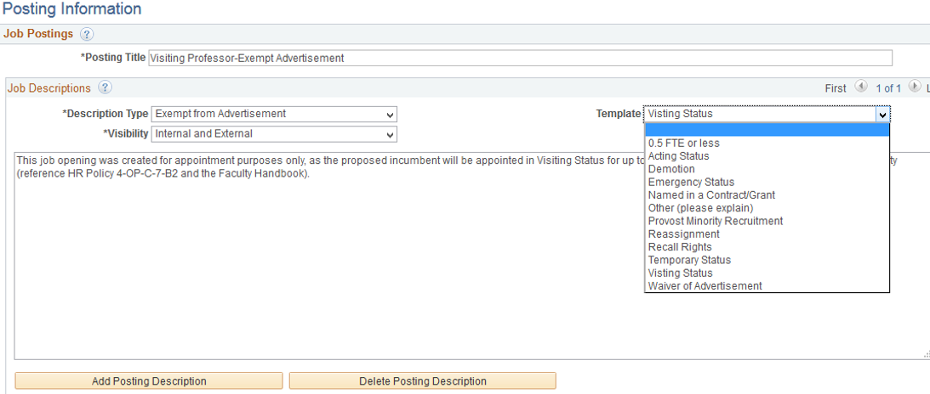
Upcoming Recruiting Enhancements Exempt from Advertisement Process
The same approval and qualifications for the advertising exemption process still apply.
Process will include electronic job application for candidate and department creation of job offer in OMNI HR.

Slide 77
Door Prize

Slide 78
Questions & Answers

Slide 79
Closing Remarks
Sarah Mirkin,
HR Communications Manager

Slide 80
Thank You!

