Slide 1
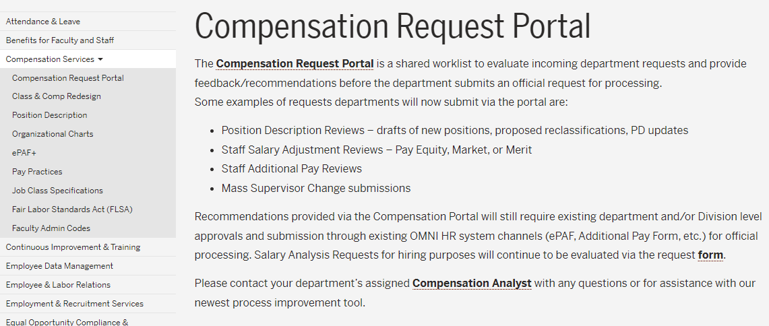
Compensation Portal Reminder
Please submit all Staff compensation and/or position review requests for initial review through the Compensation Portal.
HR Website > Compensation Services > Compensation Request Portal

Slide 2

Are You Active On LinkedIn?
Amplify your department’s brand and build trust.
Share FSU job postings on LinkedIn to professional networks and build interest.
Reach and engage your prospects.

Slide 3

What is Talent Acquisition?
Attracting the right talent through branding, outreach, and storytelling.
Engaging candidates with meaningful and personal connections and experiences.
Helping hiring teams select individuals who align with our mission, values, and goals.
Partnering with departments to anticipate and plan for workforce needs and changes.

Slide 4

Planning to advertise a job externally?
Contact your department’s Employment Specialist
for requirements and resources.

Slide 5

OPS Job Posting Reminders
OPS is for short-term/temporary employment.
Fill out the Job Info tab and include “OPS” in the title.
Refer to the Job Aid for more key details and steps to create an OPS Job Opening.

Slide 6


Did you check for Veterans’ Preference?
Review the Screening and Routing emails from HR for eligible Veterans.
Eligible Veterans MUST be interviewed for USPS positions and given preference for consideration at every step of the process.
Reach out timely! Contact your assigned Employment Specialist if you are having trouble reaching a candidate.
Questions? Contact our HR Veterans Liaison, Lindsay Holzmacher at veteran-jobs@fsu.edu.

Slide 7

Open Until Filled Reminders
Make sure to CLOSE postings that are Open Until Filled as soon as a top candidate is identified.
Contact your Employment Specialist to close the posting!

Slide 8

Navigating the Recruitment Market
Tip: When appropriate, contingent offer letters can be issued prior to the Onboarding process using the templates on the HR Website.

Slide 9

Express Pools Hiring Reminders
Summer 2026 Express Pools have been created!
Each Express hire requires the department to create a new appointment record, link it, and prepare a job offer.
Refer to Training Guides for details.

Slide 10

Have you taken the online
OPS Hiring Training?
Hop aboard the OPS Hiring Express and learn how to appoint OPS, GA, OPS Faculty, Courtesy, and One Time Pay hires!
Register today—Course Name: OPS Hiring Express Online, Course Number: BTREC3

Slide 11

Helpful HR Query Alert
FSU_OFFER_PEND_APPR_DEPREP_USE shows all pending offers, per department ID, at the current workflow step.
Great tool for departments to track the status of offers!

Slide 12

HR Policy Reminder
When reviewing Employment of Relatives requests in the Onboarding portal, supervisors must review for any direct or indirect reporting per the policy.
Questions? Contact your Employment Specialist

Slide 13

Onboarding Reminders
Check “My Tasks” regularly for action items.
Monitor the status of workflow items (dual comp, outside employment, employment of relatives) to ensure timely approvals.
Use HR Query FSU_SM_PEND_CAND_STEP_BY_DEPT to monitor the progress of your candidates in Onboarding.

Slide 14

Have you taken the online
Onboarding Portal Training?
Register today for course BTSMT0

Slide 15

Records Retention for Recruiting Efforts
Departments must keep all hiring documentation for 4 years.
This changes to 5 years when hiring a foreign national.

Slide 16
Activating the FSUID
When can an employee activate their FSUID?
An employee’s FSUID account can be activated within the following number of days prior to their official start date, but only after Human Resources has processed the employee’s hire in OMNI HR.
  USPS, OPS, Courtesy employees – 3 days
  A&P employees – 7 days
  Faculty and Executive Service employees – 60 days
To avoid complications with FSUID account management, employees should not activate prior to the related window.

Slide 17
Employee Information in OMNI HR
Please remind employees to keep their personal and payroll information up-to-date in OMNI HR.
Phone, address (home, mailing, and email), W-4, direct deposit, and emergency contact information can be reviewed and updated online by selecting “Personal Information” in OMNI Self Service.

Slide 18

Onboarding and Hiring Documents Reminders
Ensure start dates are two weeks out to allow time for the job offer, background check, and onboarding to be processed.
For timely processing, be mindful of payroll deadlines!
See the Appointment Papers Matrix for requirements.

Slide 19
Service Center Cases
If your appointment action met the payroll deadline, and it has been 5 business days since you submitted it to HR, you can email hr-edm@fsu.edu for an update.
If the action is payroll sensitive and met deadline, submit a Service Center Case to request expedited processing.
Is there a financial emergency after the payroll cycle?
If yes, request an Off Cycle Check.

Slide 20
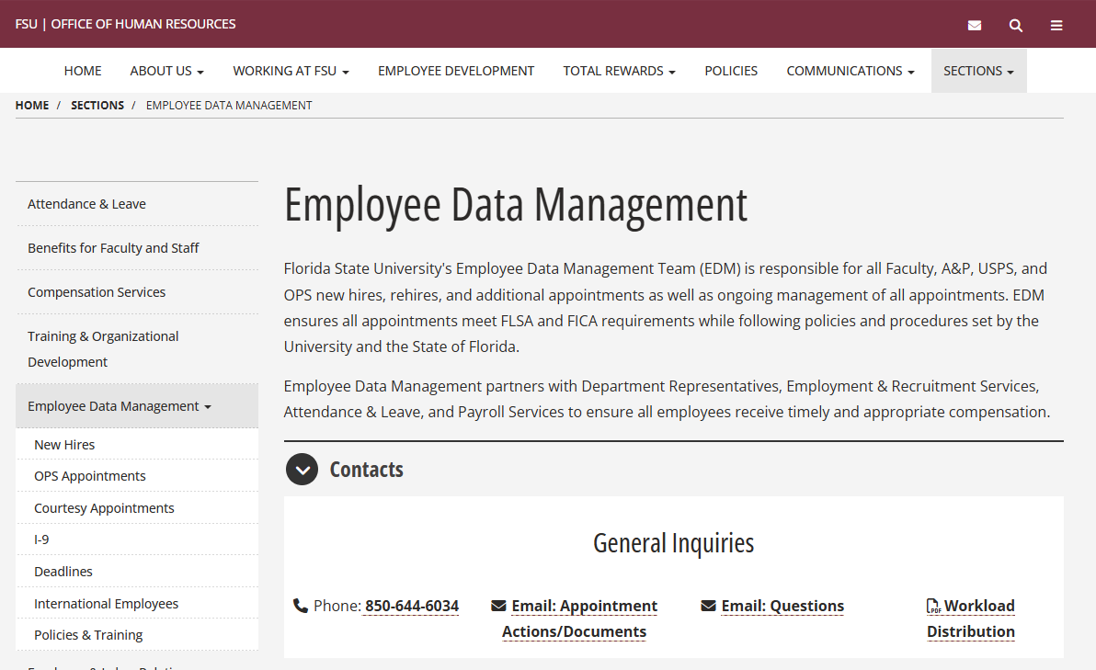
Who Should I Contact?
Employee Data Management (EDM) has added a Workload Distribution list to the Contacts section on the HR Website.
Save this or print it for guidance on who to contact for specific actions.
HR Website > Sections > Employee Data Management > Contacts

Slide 21
Graduate Assistant Appointment Reminder
All spring appointments must have a minimum appointment period of at least 5 business days before the first day of classes through the last day of finals as outlined in the academic calendar.

Slide 22

Minimum Wage Reminders
Graduate Assistants: $24.45
OPS: $14.00

Slide 23


Graduate Assistant Mass Reappointment
Summer 2026 Grad Mass process
closes to Dept Reps on April 9, 2026
For questions, contact Amelia Colorado.

Slide 24

Courtesy Appointment Reminders
Courtesy Appointments use special, unpaid job codes. Ensure all appointments are submitted with the correct Courtesy Job Codes.
RAMP approval attachments for unaffiliated courtesies need to show the Visitor Information tab.
Don't forget to check My Tasks in onboarding!

Slide 25
Public Service Loan Forgiveness (PSLF)
PSLF Forms and questions can be sent to
HR-Records@fsu.edu for processing.

Slide 26

Work-Related Injuries
Departments are strongly encouraged to accommodate functional limitations following a work-related injury. When an injured worker has been released to modified duty by their physician, a determination of the availability of such assignment should be made within 24 hours.
Please work with Briana Geleta-Francis bg23m@fsu.edu or 850-645-2731

Slide 27
A&L Reminders
Payroll processing for pay period X (pay period ending 5/21/26) will be accelerated by 1 day.
Compensatory Leave must be exhausted before Vacation Leave can be utilized.
Departments can monitor their department’s compliance by running FSU_TL_VACHT_W_COMP_BAL weekly.

Slide 28
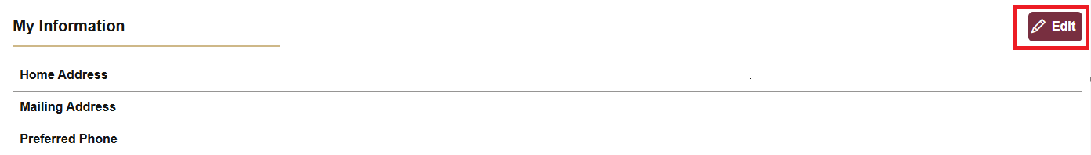
Personal Information Updates in OMNI
Employee information updated in OMNI is automatically reported to People First and the Florida Retirement System (FRS).
Employees are encouraged to update and review their information regularly to ensure any updates and communications are completed and received timely.

Slide 29
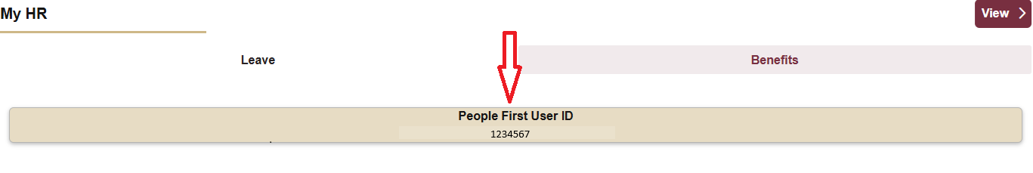
People First ID
Employees can locate their People First User ID on the MyFSU Benefits tab.
  New-to-state-employment employees will have their People First ID available on their second day of employment.
  New hires with previous state employment will log in to People First using their original People First ID.
    The User ID on the MyFSU profile is not incorrect for these hires. It is the ID associated with their FSU employment.

Slide 30
Health Insurance Coverage
Employees hired on the last day of the month will not be able to elect health insurance coverage on the next day (first day of the following month).
Coverage will begin the first day of the second month following the month of hire.
    Example: Hire date is March 31.
    Coverage will begin May 1.

Slide 31
OPS Involuntary Terminations
All OPS involuntary terminations due to performance and/or conduct must be reviewed by Employee & Labor Relations prior to terminating the employee.
Although OPS employees work on an at-will basis, ELR must be involved prior to involuntary terminations to ensure there is a legally justifiable reason for the termination.

Slide 32

Annual Poster Audit
HR will be conducting the Annual Federal/State Labor Law Compliance Poster Audit later this spring.
  Please take the opportunity to review all compliance posters and locations to ensure they are current and compliant.
You will be notified of the audit dates in a separate communication. Current compliance posters are on the Human Resources Website.

Slide 33




Department Rep and Supervisor Training
Participate in professional development designed for department reps, admin professionals, supervisors, and hiring managers involved in HR tasks!
Scan the QR code to explore the training requirements for each certificate program. For questions or registration help, reach out to training@fsu.edu or (850) 644-8724 anytime!
Notes:
HR Bootcamp: This series provides comprehensive overviews of HR and department timeliness, tasks, deadlines, and processes. HR subject matter experts facilitate Bootcamp in partnership with an expert-level department representative. This unique format provides both the HR and Rep perspective for completing HR duties in the department. There are three HR Bootcamp courses in the series.
HR Department Rep Certificate: The training series is designed for FSU department representatives, administrative professionals, and hiring managers who are directly involved in HR-related tasks. It's ideal for both new HR reps and seasoned staff looking to deepen their understanding of FSU's HR processes. This series is delivered through a blend of in-person and self-paced online learning.
Supervisor Excellence: Compliance Essentials Certificate is designed to enhance the understanding of employment compliance policies and practices essential for success in supervisory roles at FSU. This series equips participants with essential knowledge and skills to effectively manage operations and enhance employee performance while maintaining ethical standards and minimizing risks.

Slide 34
OBBBA - No tax on Overtime
Overtime pay continues to be taxed through payroll. The “no tax” headline refers to a personal income tax deduction, not a payroll exemption. Employees will still see taxes withheld on overtime earnings, but may deduct up to $12,500 in qualified overtime premiums on their federal tax return.
The deductible amount is limited to the overtime premium, representing only the additional 0.5× portion of standard overtime pay. Typically, overtime is paid at 1.5× the regular hourly rate. For example:
  If an employee earns $20/hour, overtime is paid at $30/hour.
  The premium portion is the extra $10/hour (0.5×) above the regular $20/hour.
  Under OBBBA, only that $10/hour premium is deductible—not the full $30/hour overtime rate.
Payroll Services will calculate the total deductible overtime premium for each employee. While the method of notification is still being finalized, for 2025, it will likely be reported on your W-2 form in Box 14.
Questions? Please contact Payroll Services at payroll@fsu.edu

Slide 35
Summer Camps Around You?
Summer Camp personnel must receive DCF Summer Camp Level 2 Background Checks
before working or volunteering. Per Section 409.175 FL Statute.
Please go to HR.FSU.EDU/BGC for Summer Camp Requirements

