Slide 1
Spring 2026 Department Representatives Meeting
April 1, 2026

Slide 2
Welcome!
Shelley Lopez
Director
HR Communications/Training

Slide 3


Thank You to Our Partners

Slide 4
Opening Remarks
Renisha Gibbs
Associate Vice President for Human Resources
Finance & Administration Chief of Staff

Slide 5

RAMP Export Control
Jordan Huston
Research Security Analyst

Slide 6
Why RAMP Export Control is Necessary
The RAMP Export Control process ensures Florida State University remains in compliance with the following:
1010.35, Fla. Stat. – Research-Related Positions
288.860, Fla. Stat. & BOG Reg. 9.012 – Foreign Countries of Concern
Personal Funding Rule

Slide 7
Why RAMP Export Control is Necessary (2)
The RAMP Export Control process ensures Florida State University remains in compliance with the following:
Federal Export Control Requirements
Visiting Scholar/Researcher Policy

Slide 8
Who Needs a RAMP Export Control Request
For All Colleges, the Libraries, and the Research Division:
All International Appointments (Paid and Unpaid)
U.S. Citizens & Permanent Residents with a “specified connection” to a Foreign Country of Concern
Unaffiliated Courtesy Appointments Engaging in Research (Intl.& Dom.)

Slide 9
Who Needs a RAMP Export Control Request (2)
For All University Personnel:
Anyone deemed a “Foreign Principal”
International Shipments
DD Form 2345 – Militarily Critical Technical Data Agreement
Anyone requiring an Initial H-1B, H-1B Extension or Amendment, or J-1

Slide 10
Documents Required for RAMP Export Control
For Initial Requests:
Foreign Government Talent Recruitment Program (FGTRP) Form
288.860 Questionnaire
Candidate’s CV/Resume
Dated & Addressed Offer Letter (If Applicable)
Full Copies of All of Candidate’s Passports (All Pages, Cover to Cover)

Slide 11
Documents Required for RAMP Export Control (2)
For Amendments (e.g., Extensions, Job Code Changes, e.g.)
Request for Amendment Form
An Updated FGTRP Form
Dated & Addressed Offer Letter (For All Job Code Changes)

Slide 12
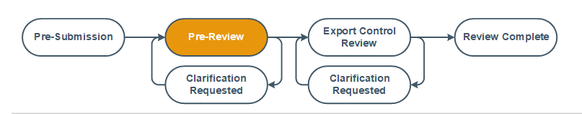
RAMP EC Process: Pre-Review
Initial Review of the RAMP EC Request
Review of Documents
Departmental Ancillary Reviews
Assess Necessary Screenings
Personal Funding, BOG, 1010.35, Visiting Scholar

Slide 13
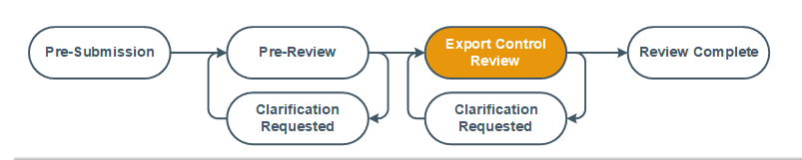
RAMP EC Process: Export Control Review
Ancillary Reviews
Personal Funding, BOG, 1010.35, Visiting Scholar
Export Control Review
Project Terms and Conditions

Slide 14
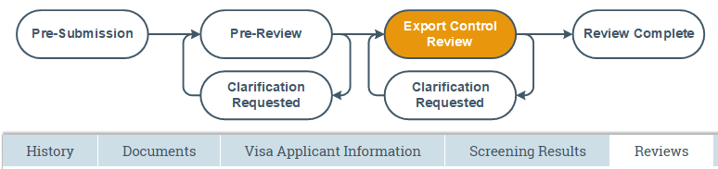
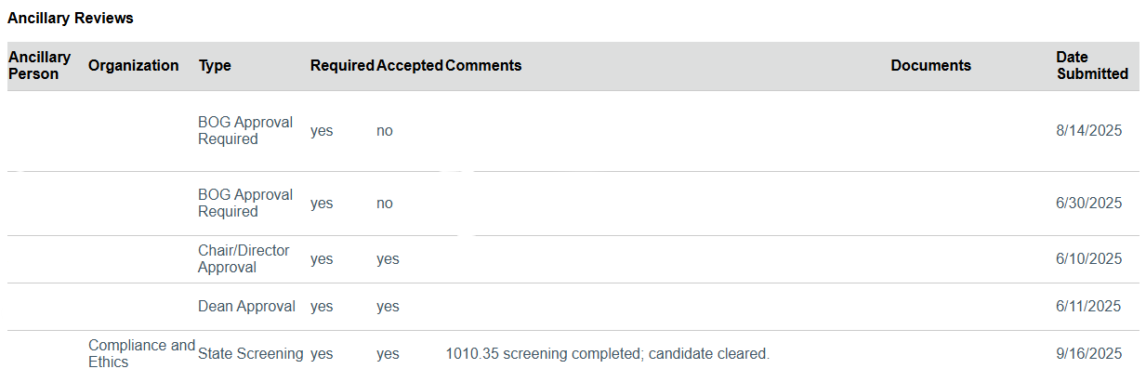
Reviews Tab: Ancillary Reviews
Please use the Reviews tab for status updates prior to contacting RISE
RISE will not move forward with the Export Control Review until all ancillary reviews have been submitted

Slide 15
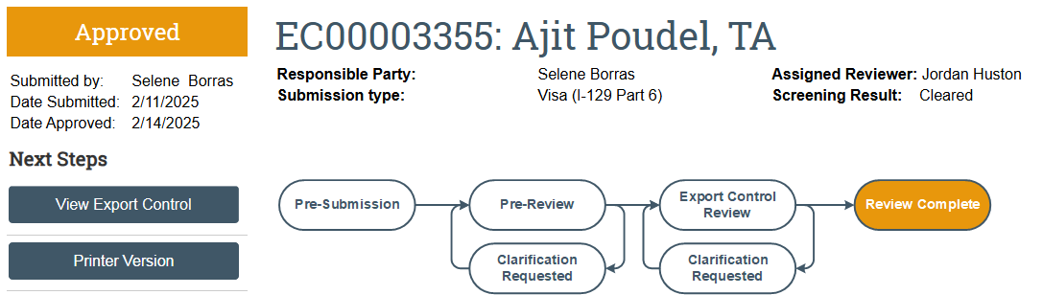
RAMP EC Process: Review Complete
This does not mean RAMP EC review is complete.
Not complete until “Approved” is listed
“Screening Result: Cleared” is for Visual Compliance
Automated screening of the candidate/visitor’s name and affiliation

Slide 16
Resources
RISE Website: research.fsu.edu/rise
RAMP Export Control Support Email: RAMP-ExportControl@fsu.edu
RAMP Export Control Help Center (Job Aides and Form Templates)

Slide 17
Future Updates
Decisions
New system for pre-appointment screenings
Goal is to replace RAMP Export Control
Benefits include:
Integrated with HR’s system
More streamlined & transparent
Roll out: TBD

Slide 18
Foreign Influence and State Screenings
Rachel Neale
Compliance Program Manager, Education and Outreach Office of Compliance & Ethics

Slide 19
Objectives
Foreign Researcher Screening vs. Foreign Principal Screening
When is foreign researcher screening needed?
When may BOG review be necessary?
Foreign principal screening process
Foreign researcher screening process

Slide 20
State Screenings
International Cultural Agreements
§288.860, Florida Statutes (2023)
Foreign Researcher Screening
§1010.35, Florida Statues (2021)

Slide 21
Agreements with Foreign Principals (§288.860)
Foreign Countries of Concern (FCoC):
Cuba, China, Iran, North Korea, Russia, Syria, Venezuela
Foreign Principals
Domiciled in a FCoC at the time of offer
Government official or member of a FCoC political party
Notes:
China: includes Macau but not Taiwan

Slide 22
Foreign Principal Screening (§288.860)
288.860 Questionnaire
Injunction

Slide 23

Does it require BOG Approval?
Hiring someone who worked in a FCoC
Collaborating with a foreign principal on a research project
Sharing data with a foreign principal
Enrolling a student from a foreign country of concern
Hiring a foreign principal for academic, administrative, or research purposes
Notes:
No
Yes
Yes
No
Yes

Slide 24

Foreign Researcher Screening (§1010.35)
Foreign researchers:
Visiting scholars
Research & research support
Non-US citizens & non-permanent residents
US citizens or permanent residents connected to a FCoC
List of job codes
Verifications:
Employment, education, publications, affiliations, etc.
Notes:
S. 1010.35, F.S (7/1/21) requires review of certain candidates for research and research-related support roles and visits.
Non-us citizens & non-permanent residents
U.S. citizens or permanent residents who have a specified affiliation with FCoC
Based on a list of job codes. If the job code is on the list and the candidate falls into one of the categories, the candidates is required to undergo screening by the OCE prior to being appointment.
If the candidate falls into the second category of U.S. citizen with an affiliation to a FCOC, a foreign researcher screening will be conducted and if they meet the definition of foreign principal, BOG approval would also be required

Slide 25

Foreign Researcher Screening (§1010.35) (2)
Required Documents/Information
Cover-to-cover passport scan(s)
Up-to-date CV/resume
All paid employment history
Full higher education history
All publications & ORC ID
US & international affiliations
Funding information
Government/military/intelligence agency/police service
Notes:
Passports: all held, meaning for all citizenships held Employment history: all paid employment since their 18th birthday, US & international, should be reported on the screening form, the last 10 years are subject to employment verification; no unpaid positions should be submitted
Higher Edu: all attended, even if short term, exchange program, transferred to another institution, or a degree was not conferred
Funding: current & pending projects & any funding that makes it possible for the candidate to participate in a visa program (scholarships/personal or family funding); funding section should never be blank

Slide 26
Steps/Stages
Department Information Form
Candidate Screening Information Form
Department initial quality control review (QCR)
Employment and education verification
Risk assessment and review
Approved/Cleared or Rejected
Notes:
Employment verification: In-house by OCE or Accurate, individual based
Rejection: candidate refuses to participate, candidate purposefully withholds/alters information, risk assessment deemed to high to approve position/visit

Slide 27

Looking Ahead!

Slide 28
OCE Resources
OCE website: compliance.fsu.edu
OCE email: compliance@fsu.edu
My email: rneale@fsu.edu

Slide 29
The Conflicts Administration Management System (CAMS) and the Disclosure of Outside Activities
Caroline Klancke, J.D., FCCP, CCEP
Associate Compliance Officer and
Director of Ethics and Integrity Programs

Slide 30
Compliance Paradigm
FSU Faculty and Staff are public employees subject to the Florida Code of Ethics (FCOE), which contains laws prohibiting Conflicts of Interest (COI). s. 112.313, F.S.

Slide 31
Compliance Paradigm (2)
In addition, FSU Researchers, Faculty, and certain others have additional transparency requirements arising from federal regulations, collective bargaining agreements, statutes located outside of the FCOE, and FSU policies—designed to mitigate COIs and Conflicts of Commitment.
Note: FSU policy does not prohibit outside activity, ownership in businesses, external appointments, volunteerism, or opportunities to serve in leadership roles or on boards.

Slide 32
Conflicts of Interest vs. Conflicts of Commitment
Conflict of Interest (COI)
A COI is any situation in which regard for a private interest tends to lead to disregard of a University duty or interest. s. 112.312(8), F.S.
In the case of Researchers, this includes situations in which an individual’s financial, professional, or personal interests outside of the University (or those of their spouse or child) affects, or has the potential to compromise, the individual’s professional judgment or objectivity. 42 CFR 50.601-607

Slide 33
Conflicts of Interest vs. Conflicts of Commitment (2)
Conflict of Interest (COI)
COIs can arise when an FSU staff/faculty member has a second job, or goes into business for themselves, or when an FSU member’s relative has business or financial interests that create conflicts or the appearance of conflicts.
COIs, once identified, can often be mitigated and managed through transparency and compliance mechanisms.

Slide 34
Conflicts of Interest vs. Conflicts of Commitment (3)
Conflicts of Commitment (COC)
A COC is an Outside Activity (OA) that has the potential to interfere with a covered individual’s time commitment to the University’s terms of employment.
COCs can occur when an employee’s professional time or effort is devoted to OA, adversely affecting their capacity to satisfy their obligations to the University.

Slide 35
Conflicts of Interest vs. Conflicts of Commitment (4)
Conflicts of Commitment (COC)
For example, when an employee attempts to balance their University responsibilities with OA, such as consulting or volunteering, they may be left with inadequate time to fulfill their University responsibilities

Slide 36
Examples: Possible Conflicts of Interest and Commitment
Being employed by a for-profit or nonprofit entity that does business with FSU
Contracting with FSU through a business you own or control, or one that is owned or controlled by your spouse or child
In your private capacity selling realty, goods, or services to FSU—either personally or through business entities that you own/control, are employed by, or wherein you serve as a compensated or uncompensated member of the Board of Directors

Slide 37
Examples: Possible Conflicts of Interest and Commitment (2)
Engaging in Outside Activity that has the potential to hinder your ability to carry out your University employment commitments, by occurrence or duration
FSU’s COI and COC disclosure process is designed to protect the independence and impartiality of public employees and officials by identifying and prospectively mitigating conflicts before they arise.

Slide 38
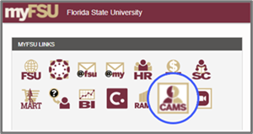
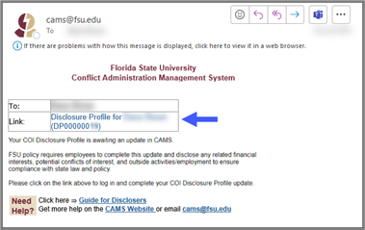
Conflicts Administration Management System (CAMS) to the Rescue!
Accessible 24/7 via the MyFSU portal
Allows for prospective disclosure and approval of Outside Activity (OA) via Pre-Approval Requests (PARs)
Allows for annual disclosure of OA for faculty, staff, and officials via CAMS link sent directly to your inbox

Slide 39
Types of Outside Activity that Should be Disclosed via CAMS
Equity - Material ownership interest in businesses
Consulting or Other Professional Services - Compensated expert advice to people or entities working in a specific field on a short-term basis (expert witness, research, product design, etc.)
Intellectual Property Rights - IP rights or royalty income paid to you
Divestiture and Cash Pay-out - Sale of equity
Sponsored Travel - Payments or reimbursements for work-related travel other than from FSU, a governmental agency, or research sponsor

Slide 40
Types of Outside Activity that Should be Disclosed via CAMS (2)
Board Service - Service on a Board of Directors of a nonprofit or for-profit entity
Outside Employment - Compensated employment external to FSU
Other Appointments - Compensated or uncompensated (appointments, fellowships, courtesy positions outside of FSU)
Honoraria - Payment of an honorarium that exceeds $5,000 or honoraria from a single entity that total more $10,000 in a calendar year
Additional guidance on what does and does not constitute Reportable Outside Activities may be found in Article 19 and Appendix K of the UFF-FSU CBA, the FSU Faculty Handbook, and specific guidance provided by your College or Department.

Slide 41
What Happens if a COI or COC is Identified?
In most cases where a COI/COC is identified, we will work with you and your College to reduce, manage, or eliminate it. Examples of reduction, management, and elimination strategies include:
Reduction of proposed hours (in cases of COC)
Assessment of whether a statutory exception is present
Adjustment of reporting or supervisory lines
Use of a Management Plan

Slide 42
What Happens if a COI or COC is Identified? (2)
The OCE works with RISE, Procurements, Contracts, HR, and others to actively identify and mitigate COIs/COCs to facilitate entrepreneurialism in full compliance with Florida law, Federal regulations, and FSU policies.

Slide 43
Compliance Specialists are Here to Help!
For Questions About COI/COC
Office of Compliance and Ethics compliance@fsu.edu
For Questions About CAMS Access/Use and Disclosure of Outside Activity
CAMS@fsu.edu
Rainey Basinger, CAMS Specialist
Research Related COI/COC Questions:
Research Integrity, Security, and Ethics research-compliance@fsu.edu

Slide 44
Employment-Based Immigration
Leslie Crosdale
Associate General Counsel
Office of General Counsel

Slide 45
Florida Board of Governors Amendment to BOG Regulation 1.001, University Board of Trustees Powers and Duties
BOG 1.001(5)(h-i): Amended the regulation to address the use of the H-1B program in universities’ personnel programs
(h) Each board of trustees shall not utilize the H-1B program in its personnel program to hire any new employees through January 5, 2027
(i) Each board of trustees personnel program must not discriminate on the basis of race, color, religion, or sex

Slide 46
H-1B BOG Regulation
Does not prohibit hiring new employees in any other visa category (ONLY prohibits hiring new employees in the H-1B category)
Does not prohibit H-1B amendments, extensions, or changes of status from F-1/J-1 to H-1B for current FSU employees
NOTE: All guidance is provided on the information that we have today and is subject to change if the BOG decides to make new/different regulations surrounding the usage of H-1Bs or other visa categories to hire personnel in our state universities

Slide 47
Options for Onboarding New International Employees
F-1 OPT or STEM OPT work authorization card
J-1 Research Scholar, Professor, or Academic Training work authorization (for non-tenure track positions only)
E-3 Australian specialty occupation visa (H-1B for Australians only)
TN visa (available to employees with Canadian or Mexican citizenship) (for non-tenure track positions only)
O-1 Extraordinary Ability visa
Any valid Employment Authorization Card

Slide 48
H-1B
2-to-3-month timeline w/Premium Processing
CANNOT be used for initial hires
Facilitated through FSU OGC (Leslie)
~$3,800 (w/Premium)

Slide 49
O-1
3-to-6-month timeline w/Premium Processing
CAN be used for initial hires
Facilitated through Fragoman
~ $9,000 (w/Premium)

Slide 50
Questions?
Leslie Crosdale
Associate General Counsel
Email: Lcrosdale@fsu.edu
Phone: (850) 644-8728

Slide 51
Center for Global Engagement (CGE) F-1 Immigration Updates
Tanya Schaad
Associate Director, CGE
Jared Tirone
Senior Immigration Advisor, CGE

Slide 52
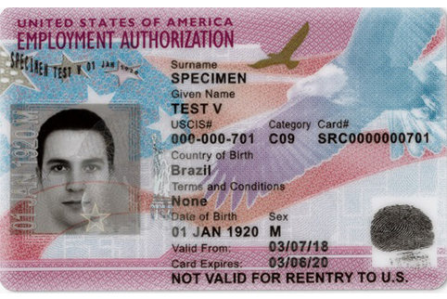
F-1 Employment Authorization Document (EAD) Update

Slide 53
F-1 Employment Authorization Document (EAD) Update (2)
New Hires in F-1 status applying for post-graduation employment authorization must attend a Biometrics appointment before USCIS will process their EAD.
FSU graduates with a Tallahassee address on their USCIS application must travel to Jacksonville for their appointment.
USCIS sets the appointment without consultation with the student/graduate, but it can be rescheduled.
Missed appointments may result in denial.

Slide 54
Employment Authorization Document Update
USCIS hold on processing is impacting:
EAD approval for citizens of 39 countries subject to visa bans
Students and recent graduates can request their OPT or STEM OPT I-20 and then submit their USCIS application, but USCIS will not issue the final approval while the hold is in place
We cannot predict when the holds will be lifted
Those who filed for a STEM extension can only work for 180 days after their original OPT card expires

Slide 55
Visa Bans and Associated USCIS Hold
Afghanistan, Angola, Antigua and Barbuda, Benin, Burkina Faso, Burma, Burundi, Chad, Republic of the Congo, Cote d ‘Ivoire, Cuba, Dominica, Equatorial Guinea, Eritrea, Gabon, The Gambia, Haiti, Iran, Laos, Libya, Malawi, Mali, Mauritania, Niger, Nigeria, Palestinian Authority Document Holders, Senegal, Sierra Leone, Somalia, South Sudan, Sudan, Syria, Tanzania, Togo, Tonga, Venezuela, Yemen, Zambia, Zimbabwe

Slide 56
Visa Bans and Associated USCIS Hold (2)
U.S. consulates will not issue new visas for travel for citizens from the 39 countries.
The bans will be reviewed again in mid-June.
Those who have a valid visa should still avoid international travel. If their passport is lost or stolen, they cannot return.
During the USCIS hold, citizens of the 39 countries will not be able to change to any other immigration status inside the U.S. to become authorized for employment.

Slide 57
RAMP EC and I-20s
We will issue a certificate of eligibility for F-1 status (I-20) for new GAs when RAMP EC is beyond pre-submission.
RAMP EC applies to teaching assistants and research assistants.
Research assistantships will take longer to clear.
Check RAMP EC frequently to ensure that students have cleared screening prior to the start of the semester in which they will be working.

Slide 58
RAMP EC and I-20s (FCoC)
FCOC for Florida (different from visa bans) includes China, Russia, Iran, North Korea, Cuba, Venezuela, and Syria.
While the injunction on FL Statute Section 288.860 is in place, allowing hiring of students from FCoC without BOT/BOG approval, we will issue an I-20 once the RAMP EC record indicates that no BOT/BOG approval is needed.
If the injunction is lifted, we will issue an I-20 for students from FCOC ONLY if the RAMP EC record shows that BOT/BOG approval is not required.

Slide 59
RAMP EC and I-20s (FCoC) (2)
Departments will be notified by the Compliance Office as soon as the injunction is lifted so that impacted students can be notified that they will not be cleared for fall to begin employment and the assistantship is rescinded but that they can still attend on personal funds, loans, or scholarships.

Slide 60
Funding Requirements for I-20s
Financial Aid typically determines the university cost of attendance each year between March and July.
The CGE uses the previous year’s cost of attendance through the upcoming Fall semester, and then we switch for Spring.
We issue certificates of eligibility (I-20s) showing 12 months of costs and funding.
We use the number of credit hours reflected in the GA offer letters.

Slide 61
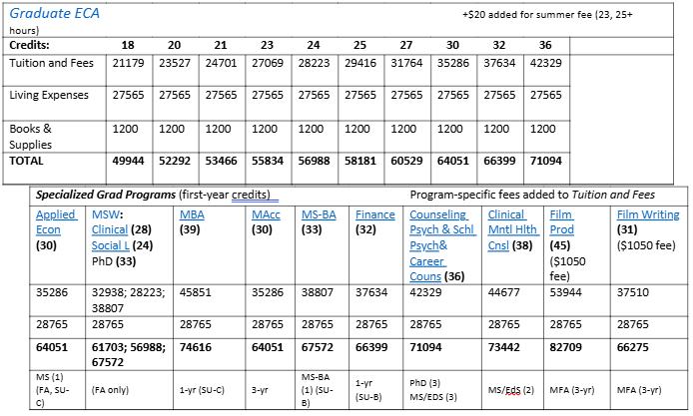
Fall 2026 Cost of Attendance

Slide 62
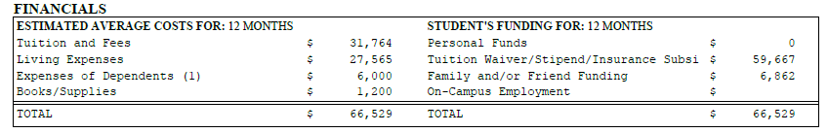
I-20 Cost of Attendance and Funding
This example shows costs for 27 credit hours and a dependent.
International students are not eligible for U.S. financial aid but may be eligible for a student loan through their home government, an international organization, or a private student loan provider. Dependents are not eligible for U.S. employment.

Slide 63
Updated SSN Process
Since the Social Security Administration now requires advance appointments, international students without an SSN can be onboarded with documentation of the appointment time and date.

Slide 64
Updated SSN Process (2)
Students apply for the SSN online and set an appointment (usually 2-3 weeks out).
Complete their arrival confirmation in Nole Start and get confirmation of immigration registration.
Obtain an SSN letter from the hiring department and bring it to the CGE for signature.
Attend their interview in person with the letter, I-20, I-94 & passport.

Slide 65
Tax Resources for International Students
Our one tax workshop was in February.
We purchased a limited number of Glacier Tax Prep licenses for those who were non-residents for tax purposes in 2025.
The licenses ran out, but students and post-docs can purchase their own license for the same product or for Sprintax.
Those who are residents for tax purposes can use any IRS Free File service.

Slide 66
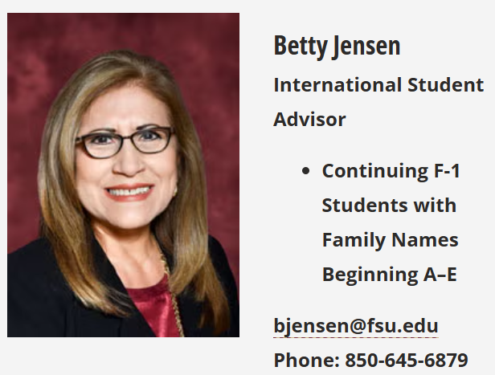
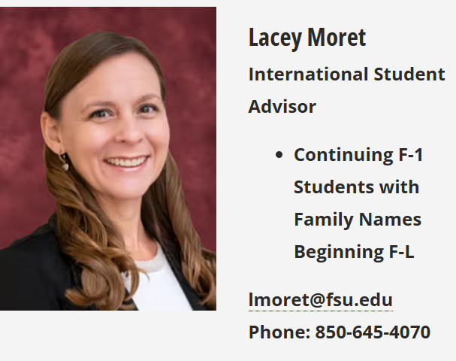
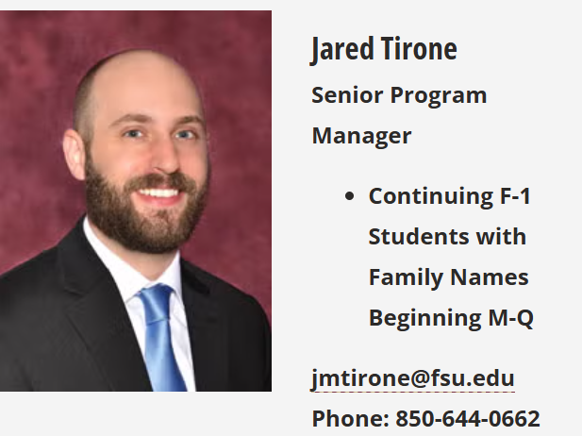
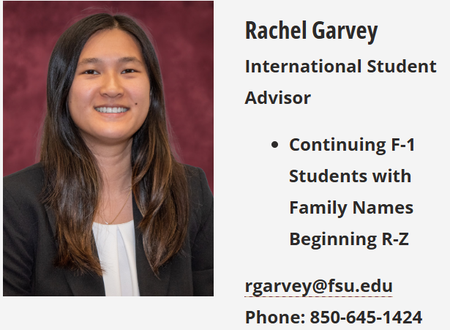
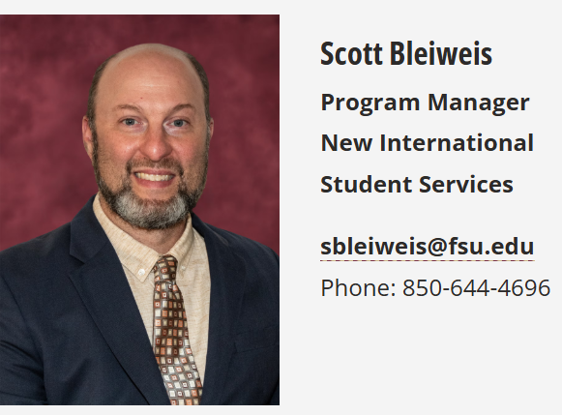
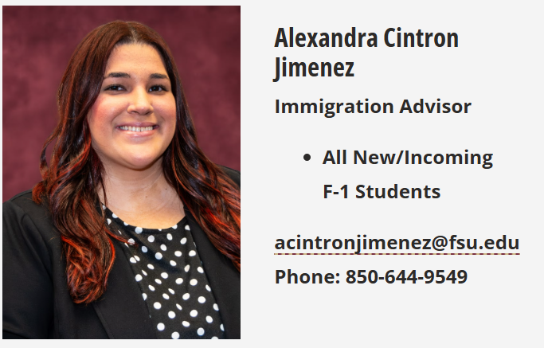
Designated School Officials
Notes:
Staff contact information can also be found at https://cge.fsu.edu/about-us/cge-staff

Slide 67
CGE Resources
Website: cge.fsu.edu
Email: cge@fsu.edu

Slide 68

Door Prize

Slide 69
Essential Piece Award
Renisha Gibbs
Associate Vice President for Human Resources
Finance & Administration Chief of Staff

Slide 70
Essential Piece Award Quotes
“She manages a high volume of complex tasks with remarkable efficiency and precision."
“She distinguishes herself through her commitment to partnership."
“She actively nurtures the professional relationship with Central HR."
“She is a pleasure to work with, bringing both a positive attitude and a solution-oriented mindset to every interaction.”

Slide 71

Bethany Kent
Spring 2026 Outstanding Department Representative and Essential Piece Award Winner
Notes:
We are thrilled to honor Bethany Kent in UBA as our Essential Piece Award winner!

Slide 72
GSWAP and I-9 Best Practices
Anna Capenos
Assistant Director
Employee Data Management

Slide 73
GSWAP Reminders (T099)
GSWAP is a placeholder for the GA record when there is no enrollment, and work will continue for the summer
The Graduate School will review for eligibility. The form is located at https://faculty-staff.gradschool.fsu.edu/faculty-staff-forms
Transfer via ePAF to the T099 job code for Summer. Attach the form

Slide 74
GSWAP Reminders (T099) (2)
If the duties will remain the same from Spring to Fall, a RAMP amendment will not be necessary
Reappointment back to GA for Fall via Grad Mass or ePAF

Slide 75
GSWAP: Three Paths
Full-time Student
Not eligible for GSWAP, must remain GA in summer, hours cannot exceed 0.75 FTE.
Part-time Student
Not eligible for GSWAP, must remain GA in summer (no waiver), hours cannot exceed 0.24 FTE
No Enrollment
Eligible for GSWAP, switch to T099 via ePAF, switch back to GA via Grad Mass or ePAF

Slide 76
Form I-9 Completion Timing Section 1
Section 1 (Employee)
Employee must complete Section 1 on or before the first day of employment
Up to one year before start date
Employee can complete Section 1 before the first day if the job offer has been accepted

Slide 77
Form I-9 Completion Timing Section 2
Section 2 (Employer or Authorized Rep)
Must complete Section 2 no later than 3 business days after the employee starts work for pay
Example: If the employee starts on a Monday, Section 2 must be completed by Thursday of that week
Exception: If the employee will work for less than 3 days, Section 2 must be completed no later than the first day of work for pay

Slide 78

Section 2: Acceptable Documents
Provide the employee with the List of Acceptable Documents
Do not specify which documentation the employee must present
Documents must be original, acceptable, and unexpired, or an acceptable receipt
An employee may present either:
One document selected from List A or
A combination of one selection from List B and one selection from List C

Slide 79
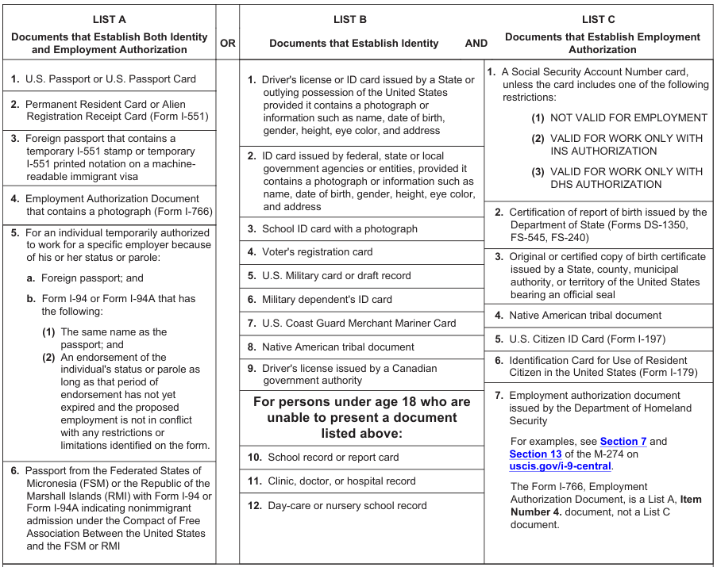
List of Acceptable Documents
Notes:
An online PDF version of the List of Acceptable Documents can be found at https://www.uscis.gov/sites/default/files/document/forms/i-9.pdf

Slide 80
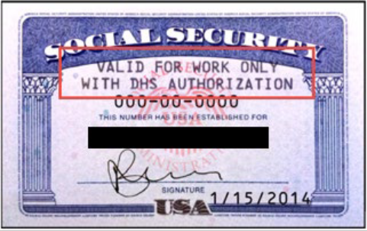
I-9 Best Practices
You can only accept unrestricted Social Security cards as a List C document
Do not accept an employee’s restricted Social Security card that is stamped with one of the following restrictions:
“VALID FOR WORK ONLY WITH DHS AUTHORIZATION”
“VALID FOR WORK ONLY WITH INS AUTHORIZATION”
“NOT VALID FOR EMPLOYMENT”

Slide 81
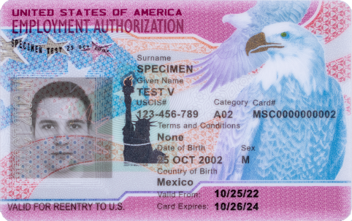
I-9 Best Practices (2)
Employment Authorization Document that contains a photograph (Form I-766)
List A Document only
Provides identity and work authorization
Upcoming Form I-9 Training on April 15 at 10:00 a.m.

Slide 82
Federal Updates Secure 2.0 & OBBBA
Christine Conley
Director
Benefits & Leave

Slide 83
Secure 2.0
Age-Based Catch-Up Contribution Changes
Beginning in 2026, catch-up contributions for high-wage earners must be made on a Roth (post-tax) basis
Applies to employees who had over $150,000 in FICA wages in 2025
Applies to those who turn 50 or older in 2026
Only catch-up contributions are subject, which would be contributions beyond the standard limit for 2026 of $24,500

Slide 84
Impacts to Retirement Plans
Voluntary 403(b)
High-wage earners will automatically have catch-up contributions converted to Roth once the standard limit is met.
Employees who do not want to contribute on a Roth (post-tax) basis must stop their contributions through Retirement@Work

Slide 85
Impacts to Retirement Plans (2)
Deferred Compensation
Reimplemented the Roth option effective January 1, 2026.
Unlike the Voluntary 403(b), employees will not have catch-up contributions automatically taken on a Roth basis.
If employees wish to contribute catch-up contributions on a Roth basis, they will need to contact the Bureau of Deferred Compensation. Otherwise, contributions will be stopped.

Slide 86
One Big Beautiful Bill
No Tax on Overtime
Deduction for overtime compensation that exceeds the regular rate of pay
For 2025, this was reported in Box 14 of your W-2
For 2026, Payroll Services and HR are working on updating our payroll system to account for the new exemption
Roll-out is TBD
No anticipated changes to the timesheet and how time iscurrently reported

Slide 87
Monitoring Required Training Completions & Digital Accessibility Compliance
Shelley Lopez
Director
HR Communications/Training

Slide 88
Monitoring Employee Completions of Required Trainings
FSU policy requires all employees to complete New Employee Orientation (NEO)
The Florida Board of Governors (BOG) requires all state university employees complete Mental Health Awareness Training
All employees include Faculty, Staff, and OPS Classifications
Notes:
-Courtesy appointments do not complete new employee orientation. Direct new courtesy appointments to the Courtesy Candidate Resources HR website.

Slide 89
New Hires Registering for New Employee Orientation
New hires must register for the NEO version that corresponds to their employment classification:
CONEO1 Faculty/Staff Version
For example: Salaried Faculty and Staff (A&P, USPS)
CONEO2 OPS Version
For example: OPS/temporary, Adjuncts, OPS Faculty, Graduate Assistants, Teaching Assistants
Notes:
- Sometimes, new employees are unsure of which training version to select. Please help advise them on their employment classification to ensure they select the correct training.
-CONEO1 & O2 – ends in the letter 'O' for online.

Slide 90
Monitoring New Employee Orientation Training Completions
Department Representatives can monitor employee NEO completions using the following HR OMNI queries:
FSU_HR_TRN_COMP_CRS_NEO_OPSFLG – This query returns employees classified as OPS who have and have not completed NEO
FSU_HR_TRN_COMP_CRS_NEO_SALFLG – This query returns employees classified as faculty or staff who have and have not completed NEO
Notes:
We recommend running quarterly queries to identify who needs to complete these required trainings. Departments should notify those individuals to complete the courses.

Slide 91
Monitoring Mental Health Awareness Training Completions
Department Representatives can monitor employee Mental Health Training completions using the following HR OMNI query:
FSU_HR_TRN_BOG_MH
This query returns employees by Department ID who have and have not completed 100% of the Mental Health Awareness Training for Faculty/Staff
Notes:
-The FSU_HR_TRN_BOG_MH query reports completions of mental health awareness in NEO, the refresher training, and former Kognito completions

Slide 92
How Do Employees Complete Mental Health Awareness Training?
For new hires: Mental Health Awareness training is part of New Employee Orientation. Completion of NEO grants credit for Mental Health Awareness.
Current employees, refresher training: Available for registration via OMNI HR Course Name: Mental Health Awareness, Course Number: COKOG2

Slide 93
Questions
For assistance with monitoring training completions, please contact Training & Organizational Development at training@fsu.edu or (850) 644-8724

Slide 94
Digital Accessibility Compliance

Slide 95
Title II of the Americans with Disabilities Act
The Americans with Disabilities Act (ADA), enacted in 1990, is a federal law that prohibits discrimination against individuals with disabilities in employment, education, transportation, and other public and private settings open to the general public. This includes FSU.
On April 24, 2024, the Department of Justice (DOJ) published a new rule on digital accessibility.

Slide 96
Title II of the Americans with Disabilities Act (2)
This rule requires FSU's web content, including academic course content, videos, documents and social media, to be ADA compliant and accessible beginning on April 24, 2026.

Slide 97
HR Department Representative Role
Review the digital accessibility standards and resources available on digitalaccessibility.fsu.edu.
Explore resources to learn how to create digitally accessible content at digitalaccessibility.fsu.edu/digital-accessibility-training.
Assist your department in updating and remediating digital materials to meet accessibility requirements.

Slide 98
HR Department Representative Role (2)
Promote awareness and understanding of these changes within your units.
Serve as a point of contact for general questions and concerns about digital accessibility.

Slide 99
Contact Information
For direct support or questions, contact the accessibility task force team at digitalaccessibility@fsu.edu.

Slide 100
Door Prize!

Slide 101
Questions & Answers
Questions & Answers

Slide 102
Thank You!

