Slide 1
FSU Basic Cybersecurity Training
A cybersecurity tutorial for Florida State University students, faculty and staff

Slide 2
Overview
Cyberthreats
Consequences
Actions
Cybersecurity at Work and Home
University Cybersecurity Resources
Cybersecurity Quiz

Slide 3
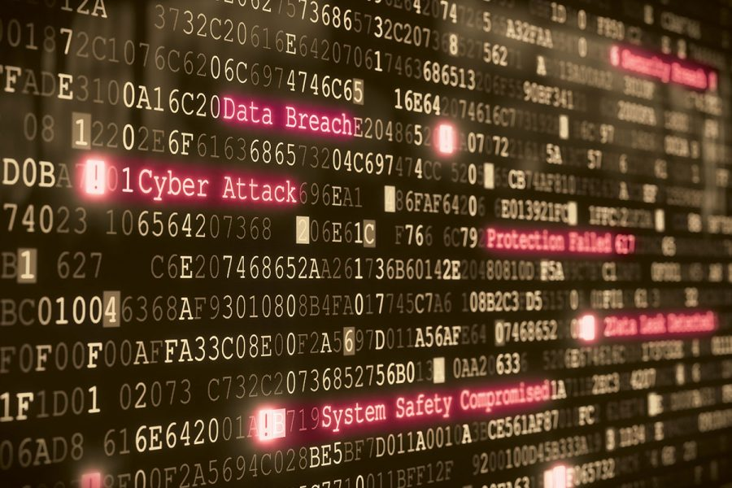
CYBERTHREATS
First, let’s talk about some common cyber safety threats and the problems they can cause.

Slide 4
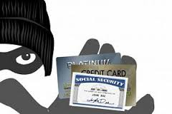
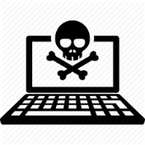
CYBERTHREATS
Identity Thieves
People who obtain unauthorized access to your personal information—such as your FSUID, SSN, bank accounts and passwords. They use this to commit crimes such as fraud or theft.
Hackers
Hackers are people who secretly get access to a computer system in order to steal information or cause damage.
Malware
Malware (short for "malicious software") is any program or file that is harmful to a computer user, including computer viruses, worms, Trojans and spyware.
Phishing
Phishing steals personal information by tricking you into clicking a link or entering your username & password. Phishing comes in many forms: emails, phone calls, website downloads.

Slide 5
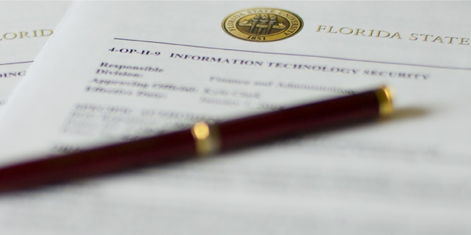
CONSEQUENCES
Defense against cybersecurity threats requires your action. If you do nothing, the results could be grave.

Slide 6
consequences
Job Hindrances
Loss of access to campus computing network
Data Loss
Loss of confidentiality and integrity
Disciplinary Actions
Lawsuits
Loss of public trust
Loss of grant opportunities
Prosecution
Internal disciplinary action
Termination of employment
Loss of valuable university info or research
Compromised personal data
Inability to access files and do work

Slide 7
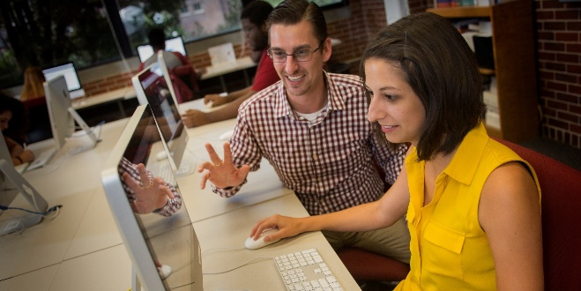
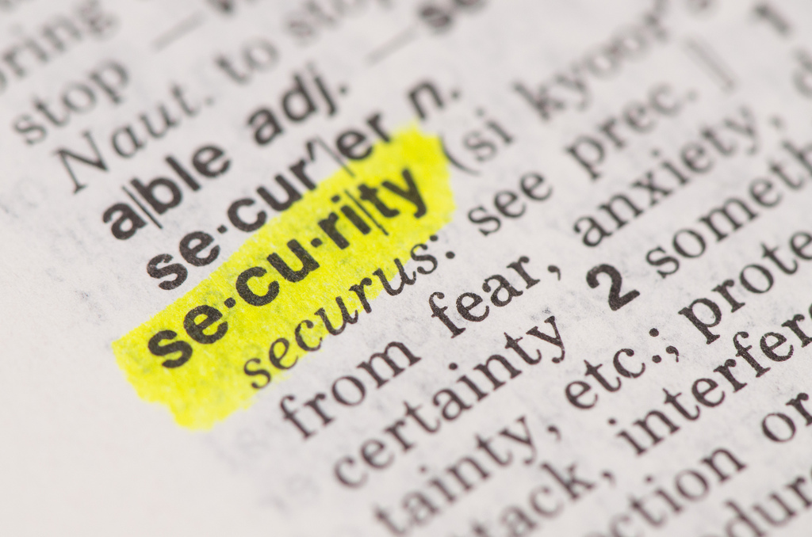
ACTIONS
Follow these tips to protect yourself, others and the university from common cybersecurity threats.

Slide 8
ACTIONS
Top Eight Cybersafety Actions
Protect Passwords
Prevent Identity Theft
Back Up Important Files
Install Updates
Avoid Malware
Run Antivirus Software
Turn On Firewalls
Beware of Phishing

Slide 9
64% of Americans have had personal info exposed by a data breach
Pew Research Center

Slide 10
Protect passwords
NEVER share your passwords with anyone!
Create strong passwords that are difficult to guess
Avoid dictionary words
Do not use common passwords, such as password1, abc123, qwerty1, letmein, yourname1
Change your passwords periodically and when creating a password
Use at least eight characters
Mix uppercase and lowercase letters, numbers and symbols
Use mnemonics to help you remember a difficult password
Example: $e^^iNo1e = Seminole
Example: W00H!TCwontW$ = Woohoo! The Cubs won the World Series
Use different passwords for different sites
Store passwords in a safe place
Never keep passwords on a sticky note near your computer
Consider using a password vault such as LastPass or KeePass

Slide 11
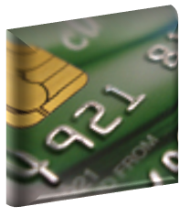
Prevent identity theft
Don’t give out Social Security numbers, driver license numbers, bank account numbers or other personal information unless you know exactly who’s receiving it
Protect other people’s information as you would your own
Never send personal or confidential information via email, text message, or instant message
Every year, order a copy of your credit report from each of the three major credit bureaus—Equifax, Experian and Trans Union
www.equifax.com
www.transunion.com
www.experian.com

Slide 12
BEWARE OF Phishing
Phishing attacks steal personal information by tricking you into doing something, like clicking a link or entering your username and password. Phishing comes in many forms: emails, phone calls, website downloads. These phishing attempts may look like they are from Florida State University—often IT Services or the Service Desk—but don’t fall for the tricks! Follow these tips to help protect yourself from phishing attacks.
REMEMBER! FSU WILL NEVER ASK YOU FOR YOUR FSUID USERNAME AND PASSWORD IN AN EMAIL OR PHONE CALL.

Slide 13
Tips to Avoid Phishing Scams
Be skeptical of messages that require “immediate action” or threaten that you will lose something.
Instead of clicking, type website addresses in your browser to access sites directly.
Before clicking, hover over or long tap a link to display the true URL and see if it is linking to a reputable website.
Think before clicking email and website links and never click a link that you don’t trust.
Do not open attachments you aren’t expecting—especially ZIP files—and NEVER run .exe files.
Avoid providing personal information over the phone, especially from an unsolicited call.
Never send credit card or other sensitive information via email.
Use common sense. If it looks like spam, then it probably is spam.

Slide 14
Avoid malware
Be wary of invitations to download software from unknown sources; even clicking advertisements can result in malware downloads like ransomware, spyware, and adware.
Ransomware is a type of malware that prevents or limits users from accessing their system—either by locking the screen or encrypting the user’s files—unless a ransom is paid
Spyware records your actions and keystrokes to steal your passwords, credit card numbers, and other confidential information
Adware not only slows your computer, but can track the sites you visit

Slide 15
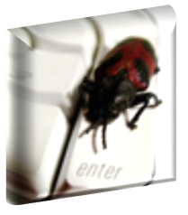
Run antivirus software
Antivirus software removes viruses and quarantines and repairs infected files and can help prevent future viruses
Viruses can be transmitted via email, email attachments or IM
To avoid computer problems caused by viruses, install and run an antivirus program like Norton, McAfee or Windows Defender
Check to see if your antivirus solution is up to date by periodically opening your antivirus program and checking the last updated date
Notes:
Ringling ITS installs and updates antivirus

Slide 16
Install Software and security updates
Updates, also known as patches, fix problems with:
Operating systems (e.g., Windows 10, Mac OS X, Android and iOS)
Software (e.g., Microsoft Office, Creative Cloud)
Apps (e.g., Wells Fargo, The Weather Channel, Facebook)
Most new operating systems are set to download updates by default.
Work computers should update automatically. Check with your IT manager to make sure this is the case. Restart your computer after updates are installed so the patches can be applied immediately.

Slide 17
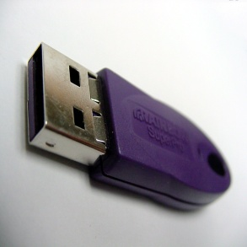
Back Up important Files
Create offline back-up copies of your files to reduce the risk of losing important files to ransomware, a virus, computer crash, theft or disaster
Save copies of your important documents and files to a flash drive, external hard drive or online back up service
Store your back-up files in a secure place away from your computer, in case of fire, theft or ransomware
Test your back up files periodically to make sure the files are accessible and readable
Notes:
Save copies of your important files to a place where Ringling backs up

Slide 18
Turn on Firewalls
Firewalls act as protective barriers between computers and the Internet
Hackers search the Internet by sending out computer messages to random computers and waiting for responses
Firewalls prevent your computer from responding to these calls
Check your computer's security settings for a built-in personal firewall and make sure it is turned on
Mac Firewall
Microsoft Firewall

Slide 19
Cybersecurity at work and home
Find out how to keep your information, computer, and other devices secure wherever you are.

Slide 20
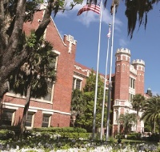
Cybersecurity at work
Work with your IT manager before implementing new cybersecurity measures
Talk with your IT manager about what cybersecurity measures are in place in your department
Avoid opening links and attachments embedded in emails if you cannot verify the source.
Use a cross-cut shredder to destroy documents containing sensitive information, such as non-directory student information, FSU proprietary documents and employee Social Security numbers and other private information
Report to your IT manager any cybersecurity policy violations, security weaknesses or any suspicious activity by unauthorized individuals in your work area
Check with your IT manager before installing any programs on your work computer
Take a moment to read the FSU information policies at its.fsu.edu//ispo/Policy
Lock your workstation when unattended
Log off your computer when you leave for the day

Slide 21
Cybersecurity at home
Never leave your laptop, tablet or phone unsupervised and in plain view
Password protect all your devices
Do not install unnecessary programs or apps on your computer or phone
Install a firewall on your home network and PC
Run a full anti-malware scan regularly
Watch what you share on social networks. Criminals can befriend you and easily gain access to a shocking amount of information.
Adhere to copyright restrictions when downloading software, games, movies or music.
Use a separate account for each family member
Set up each account as a standard account
Have a separate account with administrator privileges
Don't use the administrator account for everyday actions
Set a screen time-out
Be careful what info you share on the phone. If someone calls you asking for sensitive information, it's okay to say no. Call the company directly to verify credentials before giving out any info.
Always be careful when clicking email attachments or links. If it's unexpected or suspicious for any reason, don't click on it.

Slide 22
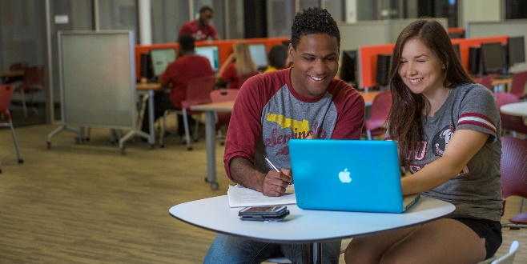
University cybersecurity resources
Find out more about cybersecurity at Florida State University

Slide 23
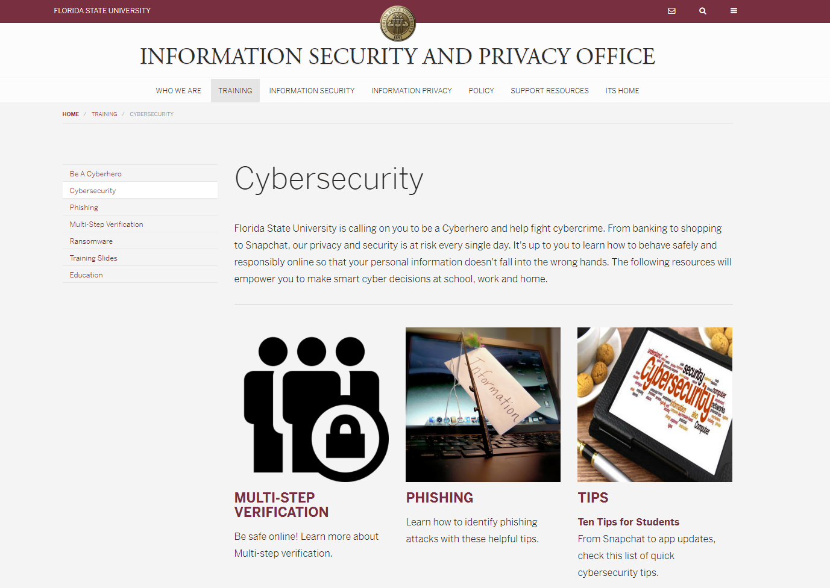
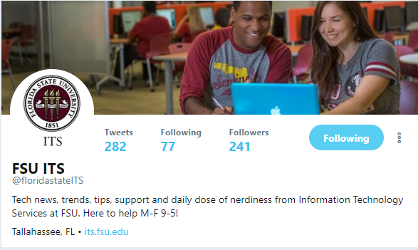
University cybersecurity resources
For more info about cybersecurity at Florida State University, visit its.fsu.edu/ispo
Follow us on Twitter @floridastateITS

Slide 24
Cybersecurity quiz
Ready to test what you learned?

Slide 25
cybersecurity quiz
Click the picture for the FSU Cybersecurity quiz!

Slide 26
Contact
Information Technology Services
Information Security & Privacy Office
Florida State University
cybersecuritytraining@fsu.edu
its.fsu.edu/ispo
Philip Kraemer, Training Coordinator
pkraemer@fsu.edu
Feel free to contact us with questions or comments on information security or privacy at Florida State University.

